Slide 1
CAPSTONE PROJECT
BITCOIN PRICE PREDICTION
Presented By:
1. FARITHA BANU A - ARUNAI ENGINEERING COLLEGE

Slide 2
OUTLINE
Problem Statement
Proposed System/Solution
System Development Approach
Algorithm & Deployment
Result
Conclusion
Future Scope
Graph Reference

Slide 3
PROBLEM STATEMENT
Develop a predictive model to forecast the price of Bitcoin cryptocurrency using historical data and relevant features, aiming for accurate predictions and adaptability to changing market conditions.
Bitcoin solved two critical problems that had plagued previous attempts at creating digital currencies:
Centralization: Early digital currencies were controlled by a central authority, which introduced a single point of failure. Having centralized control created risks such as secret money creation, hacking, or government shutdowns.
Double Spending: Ensuring that digital currency isn’t duplicated or double- spent was a challenge. Bitcoin’s blockchain technology solves this problem
by providing a secure and transparent ledger that prevents double spending1.

Slide 4
PROPOSED SOLUTION
Technical Analysis: Analyzing historical price data, trading volume, and market trends using various indicators and chart patterns to predict future price
movements.
Machine Learning Models: Utilizing machine learning algorithms such as
regression, neural networks, or decision trees to analyze large datasets of historical market data and identify patterns that may predict future price movements.
Sentiment Analysis: Monitoring social media, news articles, and other sources of market sentiment to gauge investor sentiment and predict price movements based on crowd behavior.
Fundamental Analysis: Examining fundamental factors such as network activity, adoption rates, regulatory developments, and macroeconomic indicators.
Hybrid Approaches: Combining multiple methods mentioned above to create more robust and accurate prediction models

Slide 5
SYSTEM APPROACH
A system approach for Bitcoin price prediction typically involves gathering and analyzing various types of data such as historical price data, market sentiment, trading volume, technical indicators, and external factors like regulatory news or macroeconomic trends. This data is then fed into a predictive model, which could be based on machine learning algorithms, statistical methods, or a combination of both. The model is trained to recognize patterns and relationships in the data to make forecasts about
future price movements. Regular updates and adjustments to the model are necessary to adapt to changing market conditions. Additionally, risk
management strategies should be implemented to account for uncertainties and mitigate potential losses.

Slide 6
ALGORITHM & DEPLOYMENT
Algorithm
Use machine learning algorithms such as LSTM neural networks for time- series prediction or regression models like ARIMA.
Deployment
After training the model with historical data, deploy it in a production
environment, such as a cloud server, where it can process new data and make real-time predictions. Regular updates and monitoring are crucial to ensure accurate predictions over time.

Slide 7
RESULT
The results of Bitcoin price prediction vary depending on the specific
approach, data used, and market conditions. However, with accurate models
and sufficient data, predictions can provide valuable insights into potential price movements. It's important to note that no prediction method can guarantee 100% accuracy, as financial markets are influenced by numerous unpredictable factors. Therefore, it’s essential to interpret predictions with caution and always consider risk management strategies when making
investment decisions.

Slide 8
CONCLUSION
In conclusion, Bitcoin price prediction involves using various algorithms and data analysis techniques to forecast future price movements. While these predictions can provide valuable insights, they are subject to uncertainties and market volatility. Therefore, it’s crucial to approach Bitcoin trading with caution, implement risk management strategies, and not solely rely on
predictions for investment decisions. Continuous monitoring, adaptation, and evaluation of prediction models are essential for staying relevant in the dynamic cryptocurrency market.

Slide 9
FUTURE SCOPE
The future scope for Bitcoin price prediction involves leveraging advanced machine learning techniques, incorporating diverse data sources, and integrating real-time analytics to enhance accuracy and enable informed decision-making in
cryptocurrency trading.

Slide 10
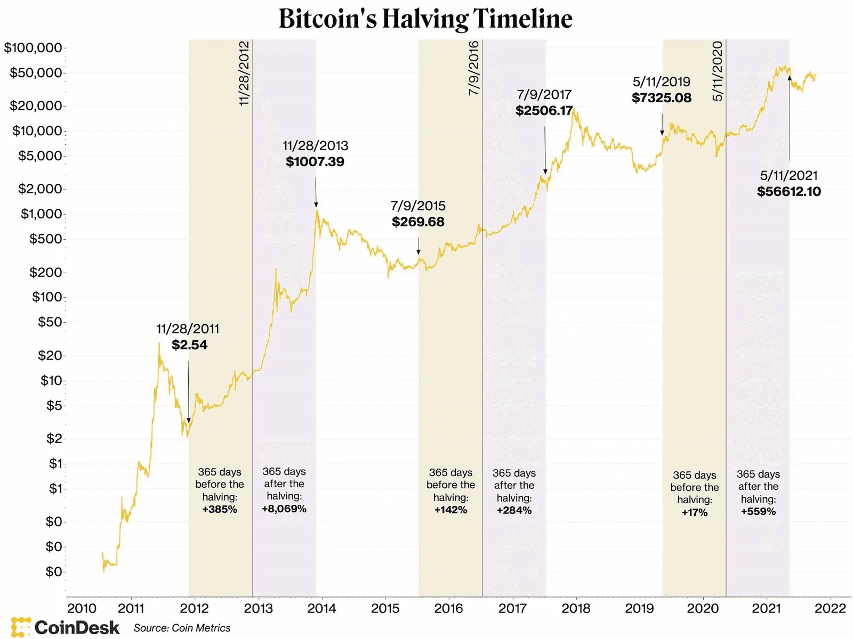
GRAPH REFERENCE

Slide 11
THANK YOU

